Slide 1
How the Grinch Killed Christmas
Alex Adams
Sam Adams
Myron Standridge
CSCI4800 Mobile Applications

Slide 2
Description
This app is a “Galaga-Style” space shooter.
The user plays as the Grinch, armed with a ship shaped as a Christmas tree with Christmas ornaments as his initial weapon of choice, and is on a mission to kill Christmas.
The user will go through levels shooting down squadrons of elves in their ships shaped like presents to get to the final boss, Santa Clause.
The practicality of this app is to provide the user with a medium to entertain.

Slide 3
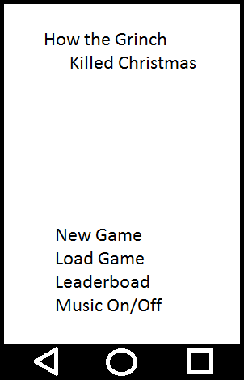
Phase I Design
Title Screen
First screen the user sees
User can start a new game or load a saved game
User can look at the leaderboard
User can turn music on or off

Slide 4
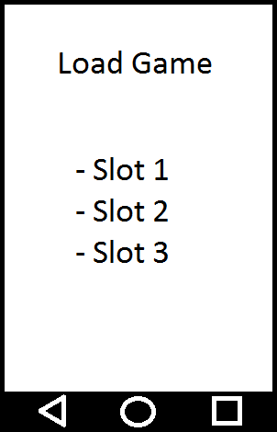
Load Saved Game Screen
User can load a saved game.

Slide 5
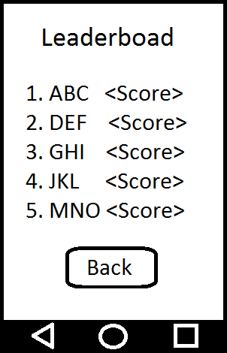
Leaderboad
User can view the top 5 recorded scores and who scored them.

Slide 6
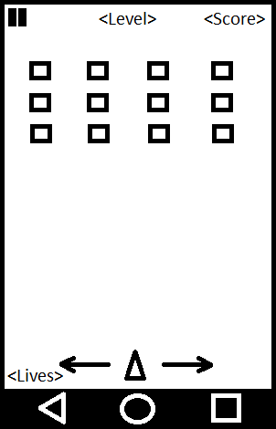
Game Screen
User can move left or right
User has to kill all enemies to clear level
User can pause game when needed
User can see the number of lives left, the current level, and current score.

Slide 7
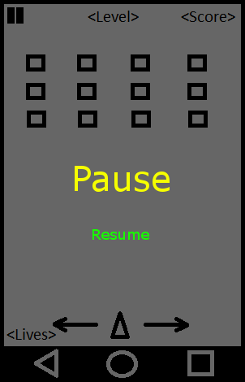
Pause Screen
The game will be paused until the user decides to resume game.

Slide 8
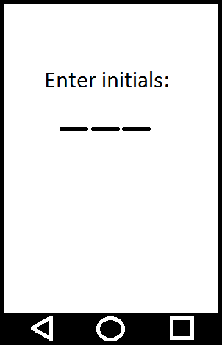
Leaderboard Initials Entry
User will be asked to enter their initials when they obtain a high score.

Slide 9
Testing Plan
Initially test it out ourselves
let random people test the complete product when at a stable build

Slide 10
Changes from Phase I
Changed from vertical to a horizontal orientation
No background… yet
No boss…. yet

Slide 11
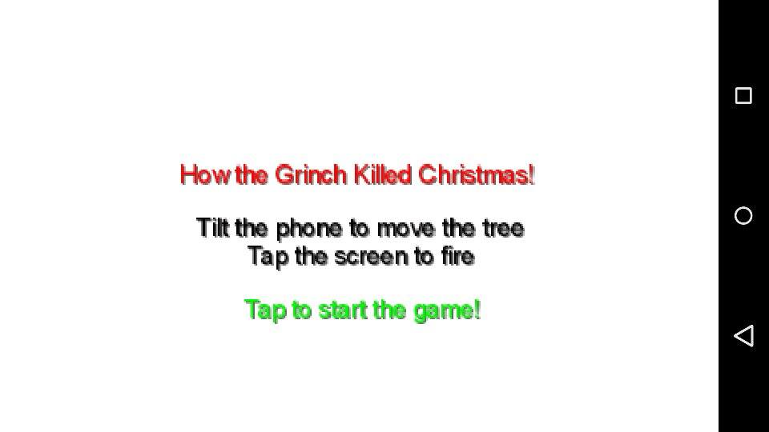
Current Screenshots

Slide 12
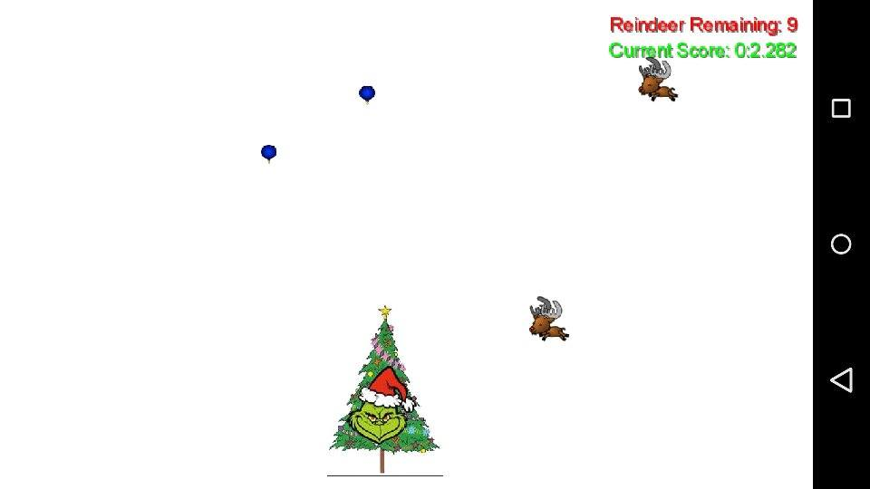

Slide 13
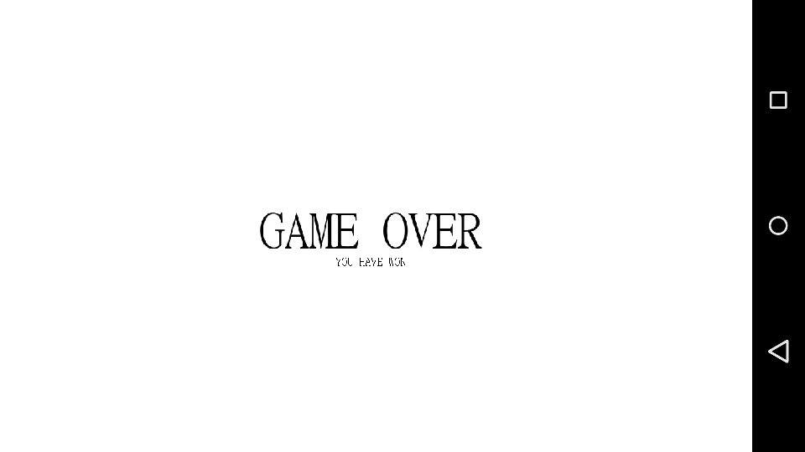

Slide 14
